Slide 1

Seaborn

Slide 2
Seaborn
Seaborn is a statistical plotting library that is specifically designed to interact well with Pandas DataFrames to create common statistical plot types.
Seaborn is built directly off of Matplotlib but uses a simpler “one-line” syntax.

Slide 3
Seaborn
When using seaborn, we trade-off customization for ease of use.
However, since its built directly off of Matplotlib, we can actually still make plt method calls to directly affect the resulting seaborn plot.

Slide 4
Seaborn
A typical seaborn plot uses one line of code, for example:
sns.scatterplot(x='salary',y='sales',data=df)
Seaborn takes in a pandas DataFrame and then the user provides the corresponding string column names for x and y (depending on the plot type)

Slide 5
Seaborn
In this section we focus on understanding the use cases for each plot and the seaborn syntax for them.
Online Docs: https://seaborn.pydata.org/
Common student question:
“How do I choose which plot to use?”

Slide 6
Seaborn
It depends on what questions or relationships you are trying to understand.
Google Image Searching “Choosing a plot visualization” will yield many useful flowcharts.
At the end of this section, you will have a good intuition of which plots to use.

Slide 7
Seaborn
Section Topics:
Scatter Plots
Distribution Plots
Categorical Plots
Comparison Plots
Seaborn Grids
Matrix Plots

Slide 8
Let’s get started!

Slide 9
Scatter Plots

Slide 10
Seaborn
Scatter plots show the relationship between two continuous features.
Recall that continuous features are numeric variables that can take any number of values between any two values.

Slide 11
Seaborn
Continuous Feature Examples
Age
Height
Salary
Temperature
Prices

Slide 12
Seaborn
A continuous feature allows for a value to always be between two values.
Not to be confused with categorical features which represent distinct and unique categories:
Colors
Shapes
Names

Slide 13
Seaborn
Scatter plots line up a set of two continuous features and plots them out as coordinates.
For example, imagine employees with salaries who sell a certain dollar amount of items each year. We could explore the relationship between employee salaries and sales amount.

Slide 14
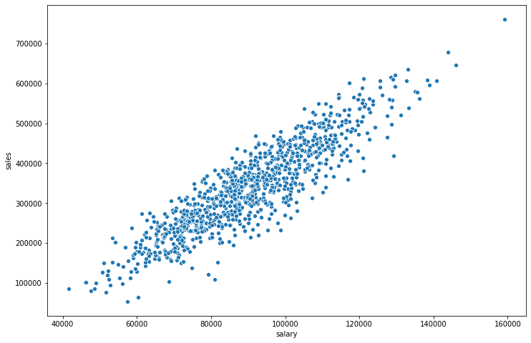
Seaborn
Plot (x,y) coordinate points

Slide 15
Seaborn
Plot (salary,sales) coordinate points

Slide 16
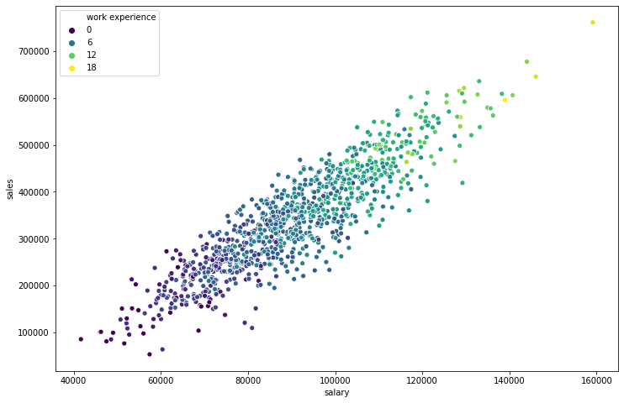
Seaborn
Seaborn can then add coloring and styling

Slide 17
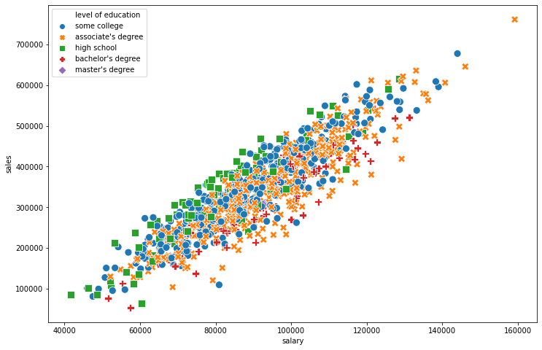
Seaborn
Seaborn can then add coloring and styling

Slide 18
Seaborn
Let’s explore Scatter Plots with seaborn!

Slide 19
Distribution Plots
PART ONE: UNDERSTANDING PLOT TYPES

Slide 20
Seaborn
Distribution plots display a single continuous feature and help visualize properties such as deviation and average values.
There are 3 main distribution plot types:
Rug Plot
Histogram
KDE Plot

Slide 21
Seaborn
Let’s explore the distribution of employee salaries.
One way to do this is through a rug plot.
A rug plot is the simplest distribution plot and merely adds a dash or tick line for every single value.
The y-axis does not really have a meaning.

Slide 22
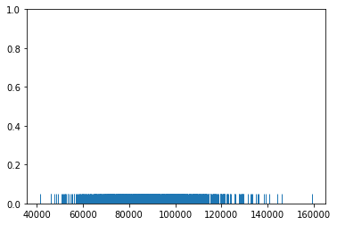
Seaborn
Rug Plot of Salaries:
Adds a tick for every salary value

Slide 23
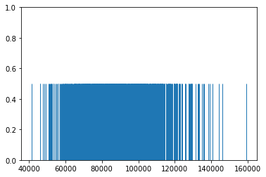
Seaborn
Rug Plot of Salaries:
Optionally adjust height of ticks

Slide 24
Seaborn
Rug Plot of Salaries:
Y-axis not interpretable

Slide 25
Seaborn
Rug Plot of Salaries:
Highest salary near $160,000

Slide 26
Seaborn
Rug Plot of Salaries:
Many salaries between $60k - $120k

Slide 27
Seaborn
Rug Plot of Salaries:
Many ticks could be right on top of eachother, we can’t tell!

Slide 28
Seaborn
If we count how many ticks there are per various x-ranges, we can create a histogram.

Slide 29
Seaborn
Let’s explore a simple example
0
10
20
30

Slide 30
Seaborn
We place the rug plot ticks
0
10
20
30

Slide 31
Seaborn
Choose a number of “bins”, we’ll pick 3
0
10
20
30

Slide 32
Seaborn
Count ticks per bin
1
3
2
0
10
20
30

Slide 33
Seaborn
Create a bar as high as count
4
3
2
1
1
3
2
0
0
10
20
30

Slide 34
Seaborn
Create a bar as high as count
4
3
2
1
1
3
2
0
0
10
20
30

Slide 35
Seaborn
Create a bar as high as count
4
3
2
1
0
0
10
20
30

Slide 36
Seaborn
Histogram is complete
4
3
2
1
0
0
10
20
30

Slide 37
Seaborn
Y-axis can also be normalized as percent
0.5
0.333
0.166
0
0
10
20
30

Slide 38
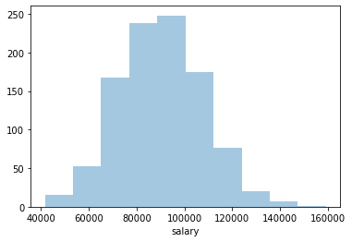
Seaborn
Changing number of bins shows more detail instead of general trends.

Slide 39
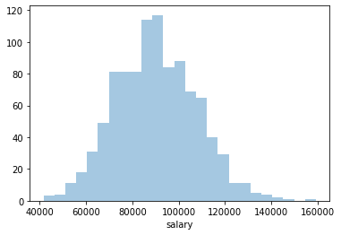
Seaborn
Changing number of bins shows more detail instead of general trends.

Slide 40
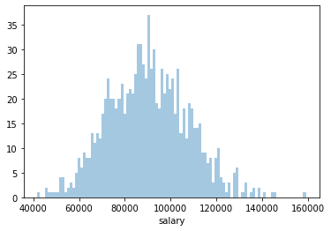
Seaborn
Changing number of bins shows more detail instead of general trends.

Slide 41
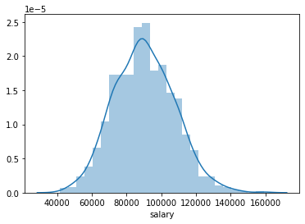
Seaborn
Seaborn also allows us to add on a KDE plot curve on top of a histogram.

Slide 42
Seaborn
Let’s explore what a KDE plot is and how it is constructed.

Slide 43
Seaborn
KDE stands for Kernel Density Estimation.
It is a method of estimating a probability density function of a random variable.
In simpler terms, it is a way of estimating a continuous probability curve for a finite data sample.

Slide 44
Seaborn
KDE plots are best understood by visualizing their “construction”.
Let’s start with a rug plot….

Slide 45
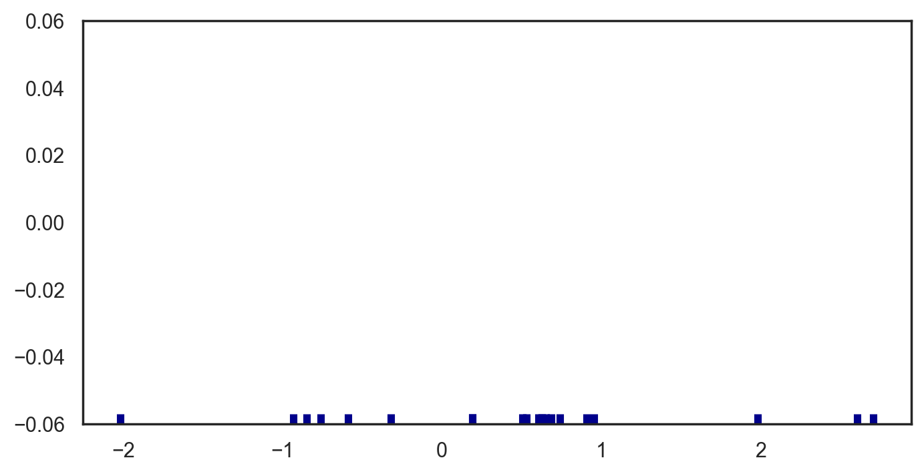
Seaborn

Slide 46
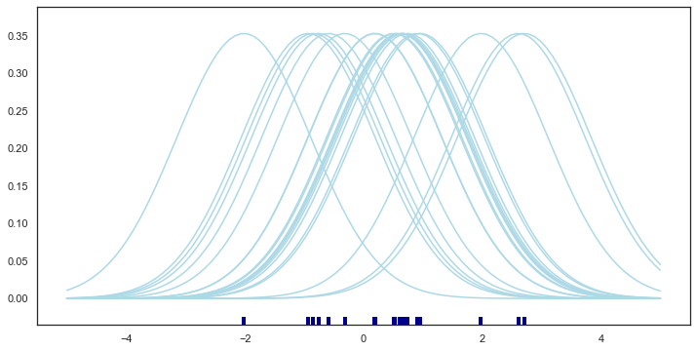
Seaborn

Slide 47
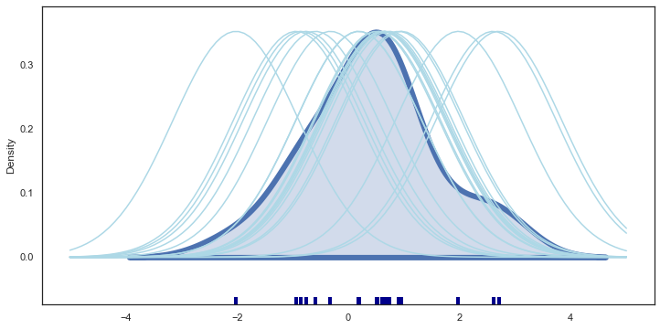
Seaborn

Slide 48
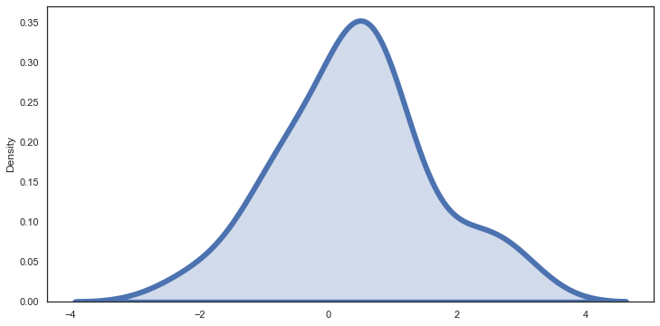
Seaborn

Slide 49
Seaborn
You can change the kernel and bandwidth used which can make your KDE show more or less of the variance contained in the data.
In the next lecture we will explore how to create these plots with python and seaborn!

Slide 50
Distribution Plots
PART TWO: CODING WITH SEABORN

Slide 51
Categorical Plots
Statistical Estimation within Categories
Part One: Understanding the Plots

Slide 52
Seaborn
The categorical plots discussed here will display a statistical metrics per a category.
For example mean value per category or a count of the number of rows per category.
It is the visualization equivalent of a groupby() call.

Slide 53
Seaborn
The two main types of plots for this are:
countplot()
Counts number of rows per category.
barplot()
General form of displaying any chosen metric per category.

Slide 54
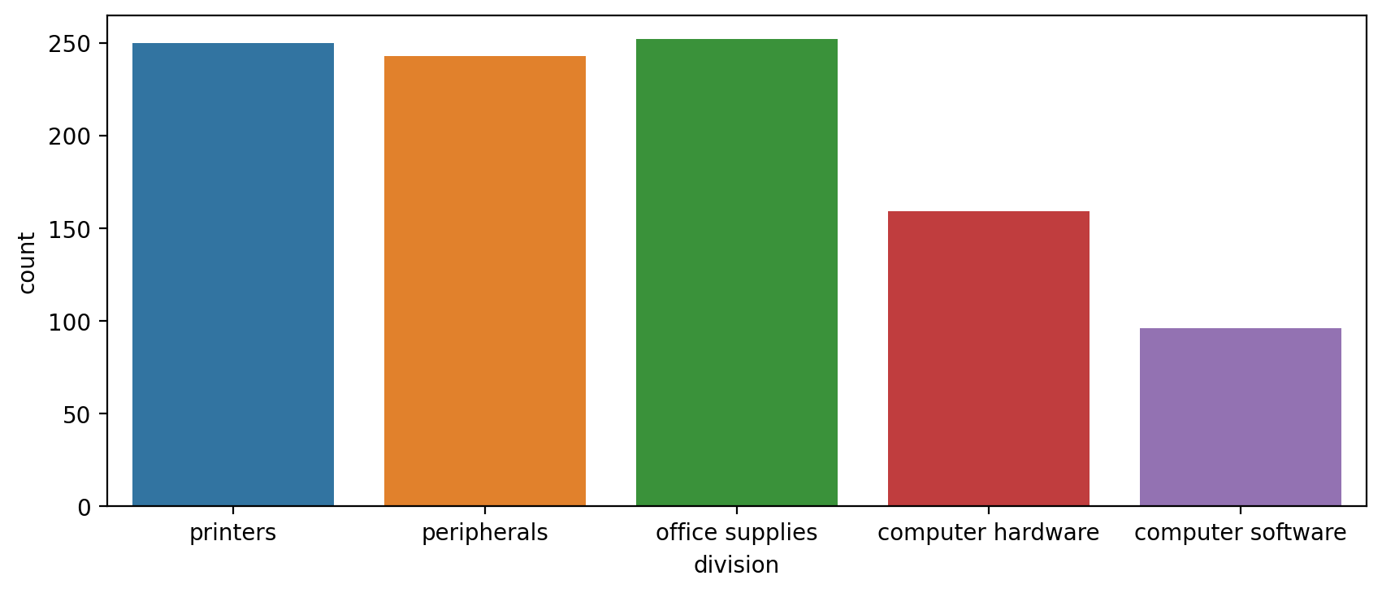
Seaborn
Countplot for corporate divisions

Slide 55
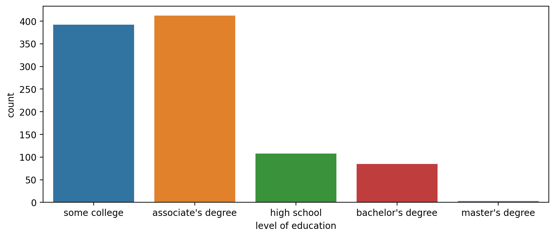
Seaborn
Countplot for education level

Slide 56
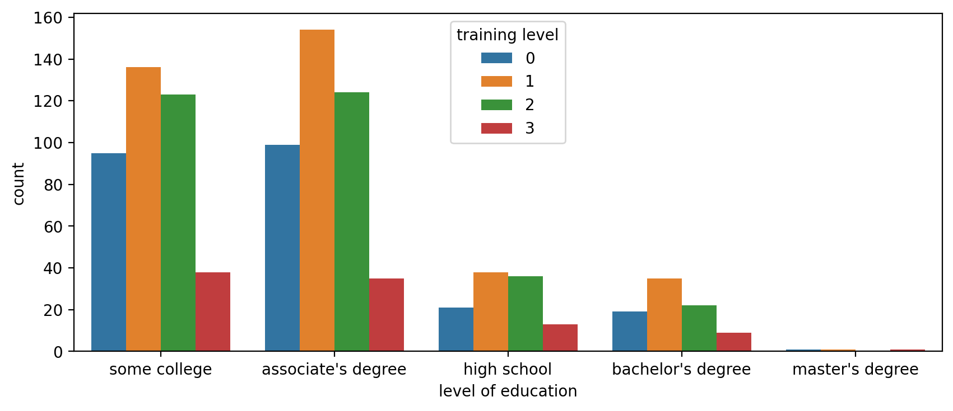
Seaborn
Countplot with additional hue separation

Slide 57
Seaborn
The barplot is the general form that allows you to choose any measure or estimator for the y axis.
We could plot the mean value and standard deviation per category instead.

Slide 58
Seaborn
Important Note!
Be very careful with these plots, since the bar is filled and continuous, a viewer may interpret continuity along the y-axis which may be incorrect!
Always make sure to add additional labeling and explanation for these plots!

Slide 59
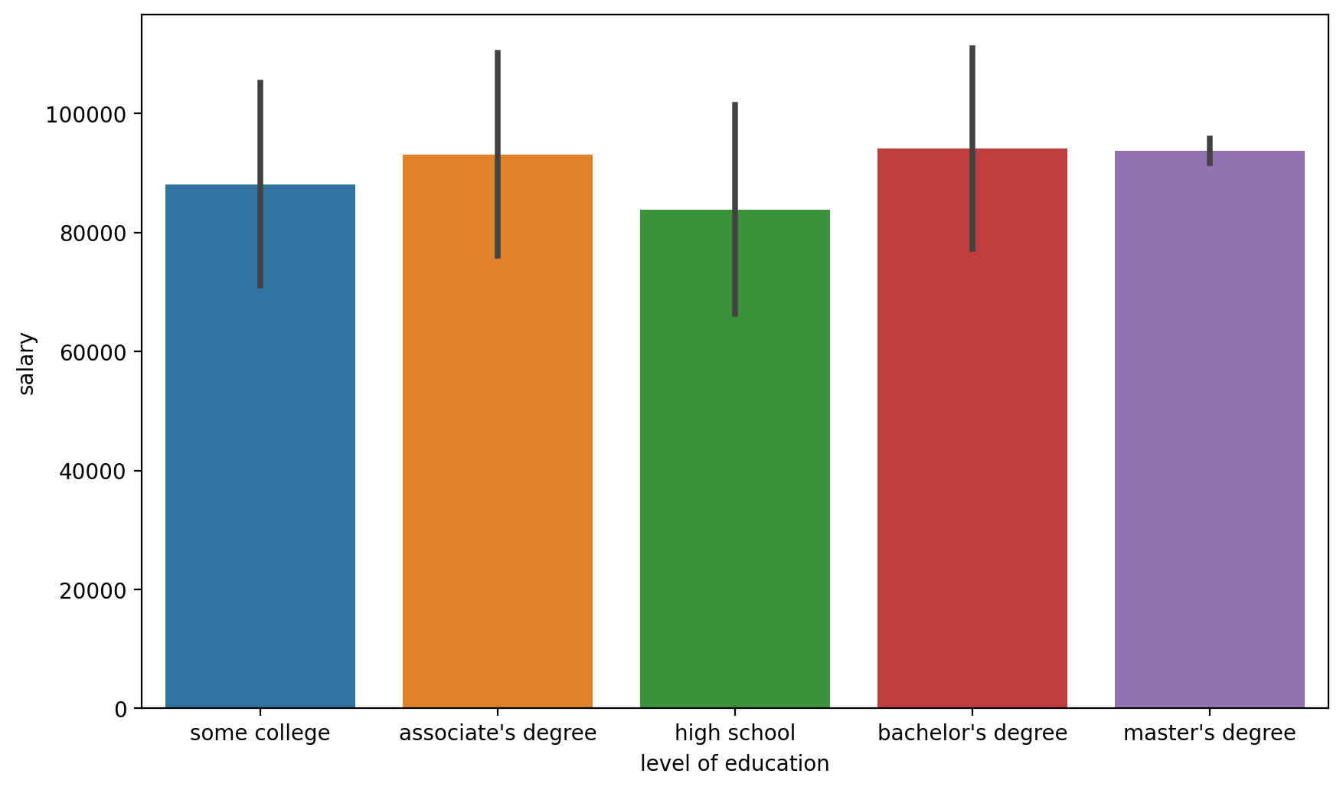
Seaborn
Barplot showing mean and SD bar

Slide 60
Seaborn
Is this best shown with a barplot?

Slide 61
Seaborn
Probably not! These are just single values!

Slide 62
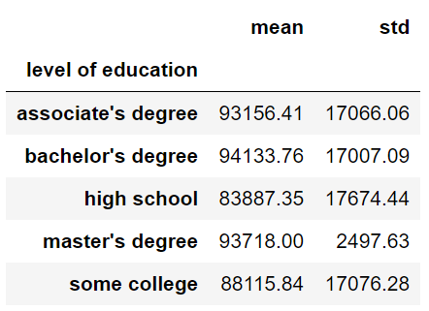
Seaborn
A simple table is probably better.

Slide 63
Seaborn
Let’s explore coding out these plots with seaborn in the next lecture!

Slide 64
Categorical Plots
Statistical Estimation within Categories
Part Two: Coding the Plots

Slide 65
Categorical Plots
Distribution within Categories
Part One: Understanding the Plots

Slide 66
Seaborn
We’ve explored distribution plots for a single feature, but what if we want to compare distributions across categories?
For example, instead of the distribution of everyone’s salary, we can compare the distributions of salaries per level of education.

Slide 67
Seaborn
We will first separate out each category, then create the distribution visualization.
Let’s explore what plot types we have available….

Slide 68
Seaborn
Distribution within Categories
Boxplot
Violinplot
Swarmplot
Boxenplot (Letter-Value Plot)
Let’s explore understanding these plots on the previous salary dataset.

Slide 69
Seaborn
The Boxplot displays the distribution of a continuous variable.
It does this through the use of quartiles.
Quartiles separate out the data into 4 equal number of data points :
25% of data points are in bottom quartile.
50th percentile (Q2) is the median.

Slide 70
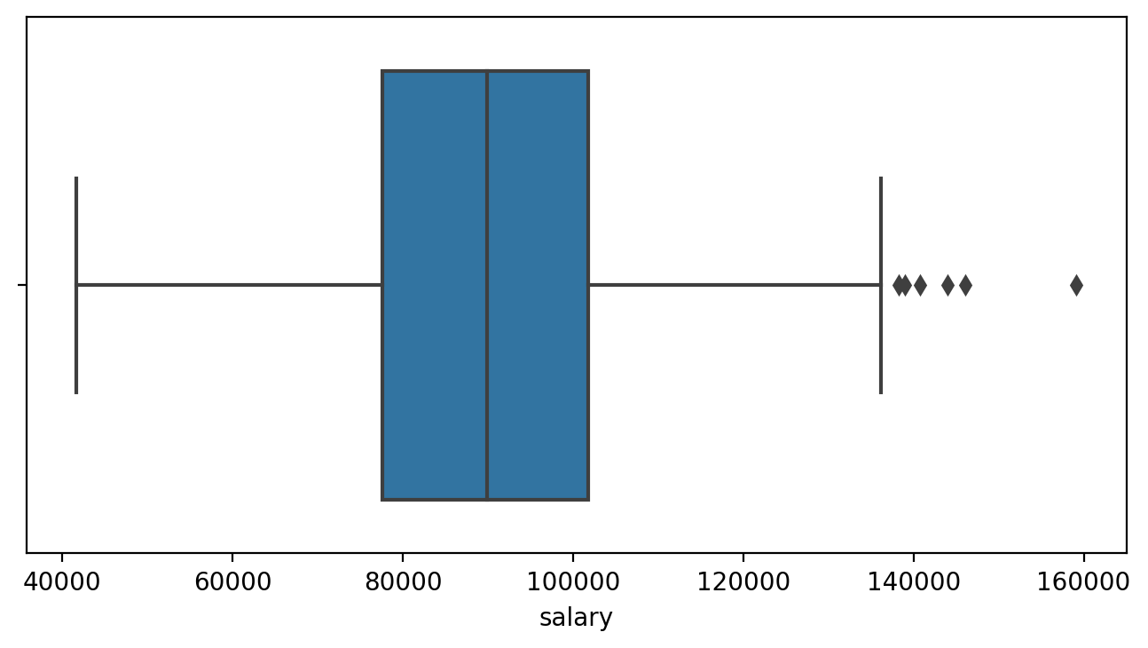
Seaborn
Boxplot on single feature:

Slide 71
Seaborn
Median is 50th percentile
Median (Q2)

Slide 72
Seaborn
Median splits data in half
Median (Q2)

Slide 73
Seaborn
IQR defines the box width
IQR - Interquartile Range
Q1
Q3

Slide 74
Seaborn
50% of all data points are inside the box
IQR - Interquartile Range
Q1
Q3

Slide 75
Seaborn
50% of all data points are inside the box
IQR
Q1
Q3

Slide 76
Seaborn
Q1 is the 25th percentile
IQR
Q1
Q3

Slide 77
Seaborn
25% of data points are below Q1
IQR
Q1
Q3

Slide 78
Seaborn
Q3 is the 75th percentile
IQR
Q1
Q3

Slide 79
Seaborn
25% of all points are above Q3
IQR
Q1
Q3

Slide 80
Seaborn
The “whiskers” are defined by 1.5 × IQR
IQR
1.5 × IQR
1.5 × IQR
Q1
Q3

Slide 81
Seaborn
Outside of the whiskers are outliers
IQR
1.5 × IQR
1.5 × IQR
Outliers
Q1
Q3

Slide 82
Seaborn
Boxplot quickly gives statistical distribution information in a visual format:

Slide 83
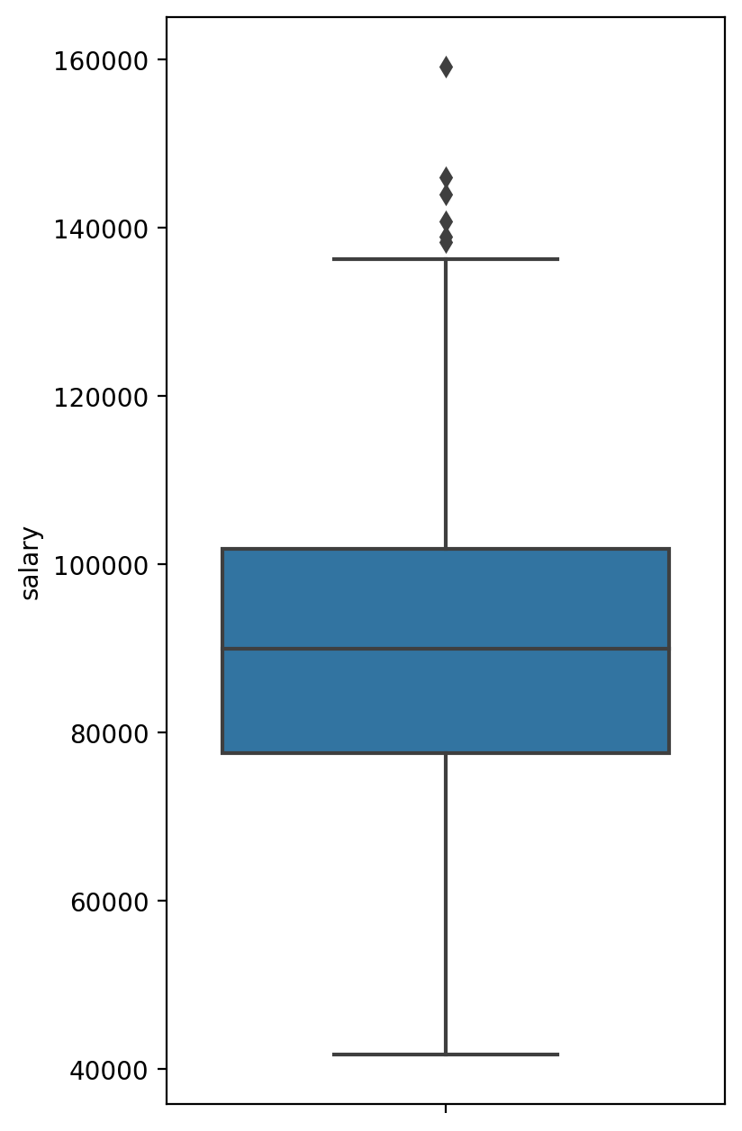
Seaborn
Boxplot can be oriented vertically or horizontally.

Slide 84
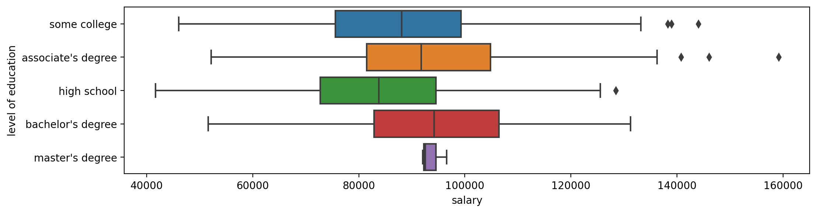
Seaborn
We can create a box plot per category!

Slide 85
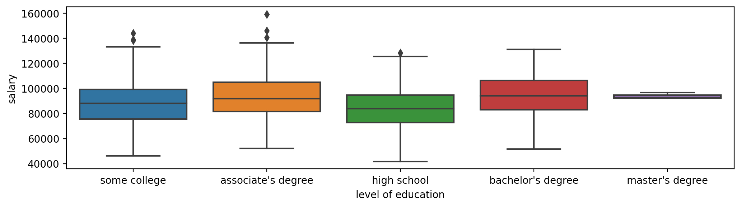
Seaborn
We can create a box plot per category!

Slide 86
Seaborn
The violin plot plays a similar role as the box plot.
It displays the probability density across the data using a KDE.
We can imagine it as a mirrored KDE plot.

Slide 87
Seaborn
The violin plot plays a similar role as the box plot.
It displays the probability density across the data using a KDE.
We can imagine it as a mirrored KDE plot.

Slide 88
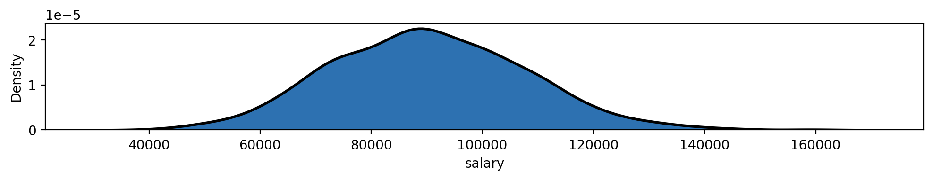
Seaborn
We take the KDE of a single feature:

Slide 89
Seaborn
We could then “mirror” it:

Slide 90
Seaborn
Then combine it to get the violin plot:

Slide 91
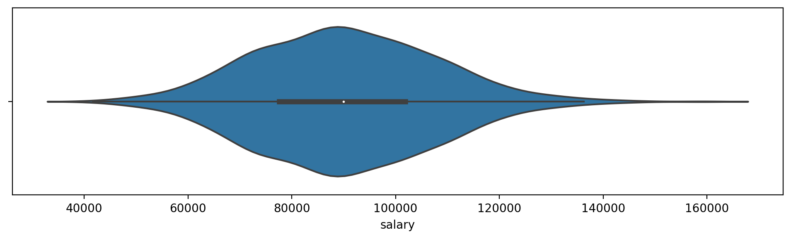
Seaborn
Then combine it to get the violin plot:

Slide 92
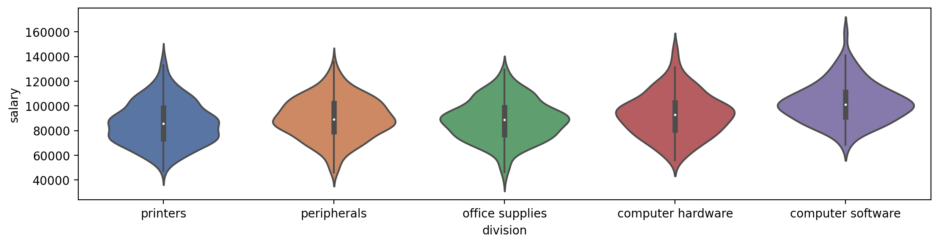
Seaborn
The violin plots can then be created per category:

Slide 93
Seaborn
The violin plots can then be created per category:

Slide 94
Seaborn
A few more less common categorical distribution plots are the swarmplot and the boxenplot.
Let’s quickly explore these plot types...

Slide 95
Seaborn
The swarmplot is very simple and simply shows all the data points in the distribution.
For very large data sets, it won’t show all the points, but will display the general distribution of them.

Slide 96
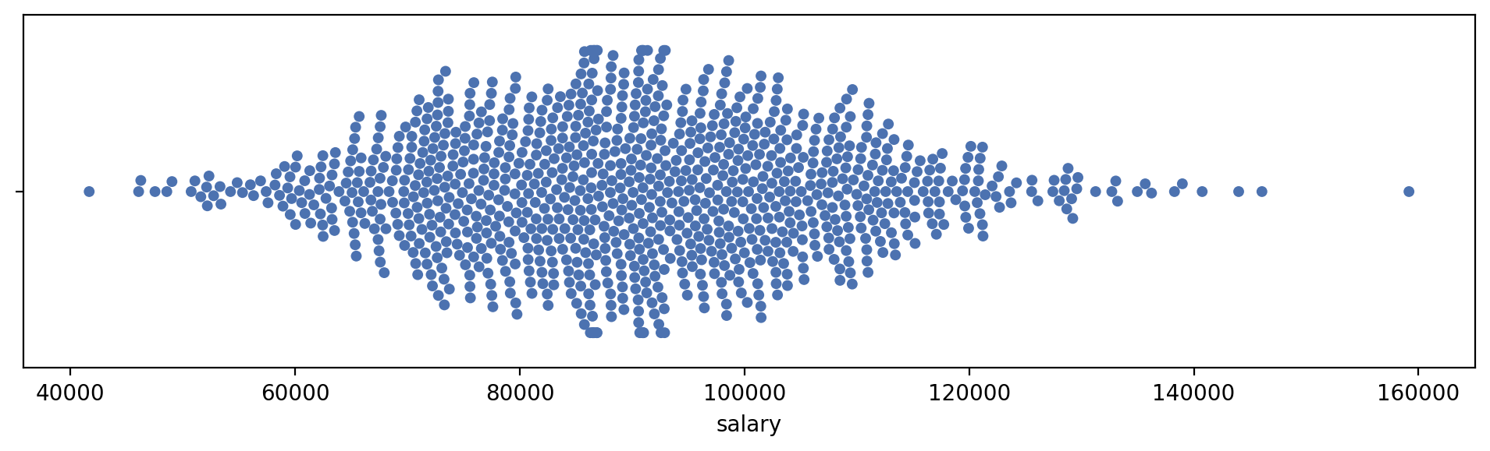
Seaborn
Swarmplot

Slide 97
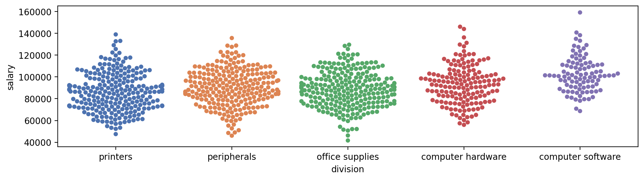
Seaborn
Swarmplot per Category

Slide 98
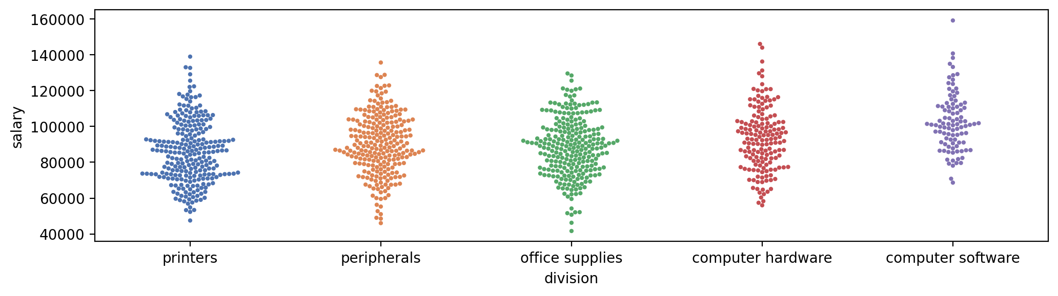
Seaborn
Change size of points to show more

Slide 99
Seaborn
The boxenplot (Letter-value plot) is a relatively new plot developed in 2011 by Heike Hofmann, Karen Kafadar, and Hadley Wickham.
Its mainly designed as an expansion upon the normal box plot.
Make sure to read the linked paper in the notebook if you end up using this plot!

Slide 100
Seaborn
Note that the boxenplot is currently very uncommon, in fact a Google search will often auto-correct this to a “boxplot” call.
Only use this plot type if you know your audience is familiar with it.
Let’s briefly explore the boxenplot and its benefits.

Slide 101
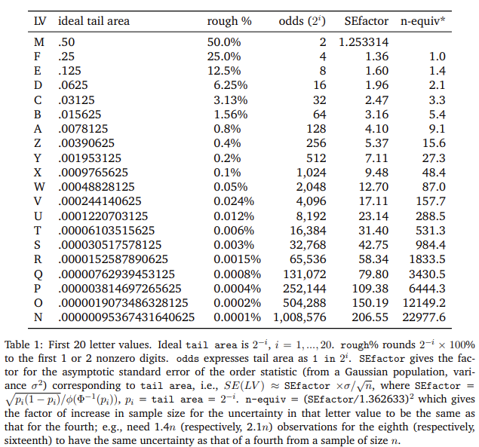
Seaborn
Using a system of letter-values we can use multiple quantiles instead of strictly quartiles.

Slide 102
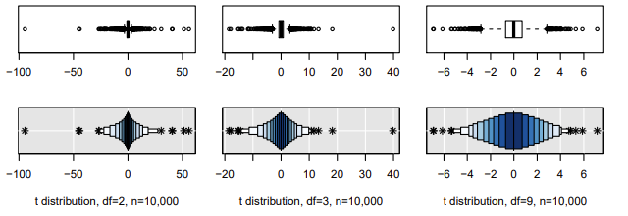
Seaborn
Boxenplot showing letter-value quantiles to display against a standard boxplot:

Slide 103
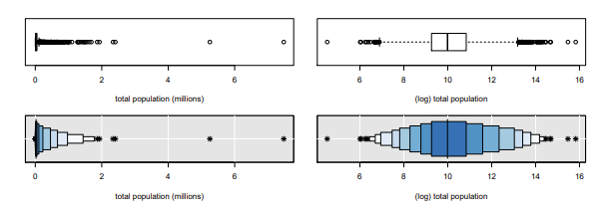
Seaborn
Boxenplot showing letter-value quantiles to display against a standard boxplot:

Slide 104
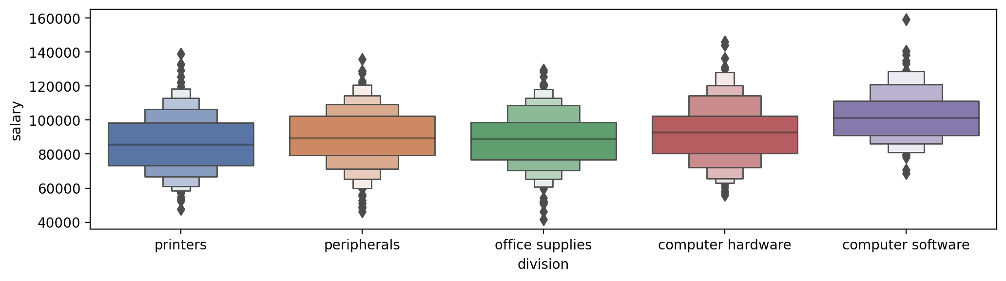
Seaborn
Boxenplot in seaborn:

Slide 105
Seaborn
Keep in mind the main purpose of data visualizations is to inform, not confuse or show-off various esoteric plots!
In the next lecture we will explore coding out these plot types.

Slide 106
Categorical Plots
Distribution within Categories
Part Two: Creating the Plots

Slide 107
Comparison Plots
Part One: Understanding the Plots

Slide 108
Seaborn
Comparison plots are essentially 2-dimensional versions of the plots we’ve learned about so far.
The two main plots types discussed here:
jointplot()
pairplot()

Slide 109
Seaborn
jointplot()
We can map histograms to each feature of a scatterplot to clarify the distributions within each feature.
We can also adjust the scatterplot to be a hex plot or a 2D KDE plot.

Slide 110
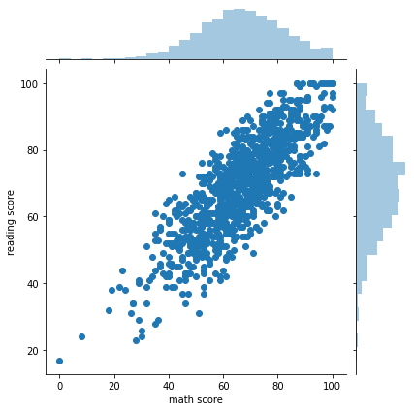
Seaborn
Histograms with Scatterplot:

Slide 111
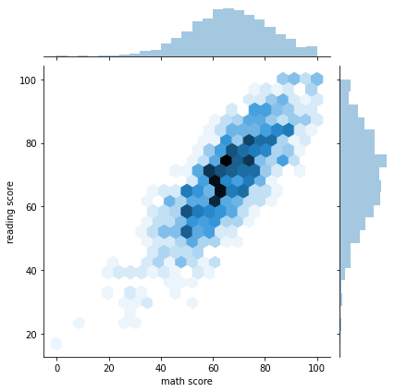
Seaborn
Histograms with hexagons:

Slide 112
Seaborn
Hexagons are dark the more points fall into their area.

Slide 113
Seaborn
Hexagons are useful when many points overlap.

Slide 114
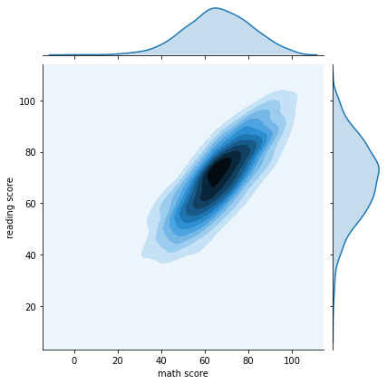
Seaborn
2D KDE plots show shaded distribution between both KDEs:

Slide 115
Seaborn
pairplot()
The pairplot() is a quick way to compare all numerical columns in a DataFrame.
It automatically creates a histogram for each column and a scatterplot comparison between all possible combinations of columns.

Slide 116
Seaborn
pairplot()
Warning!
pairplot() can be CPU and RAM intensive for large DataFrames with many columns.
It is a good idea to first filter down to only the columns you are interested in.

Slide 117
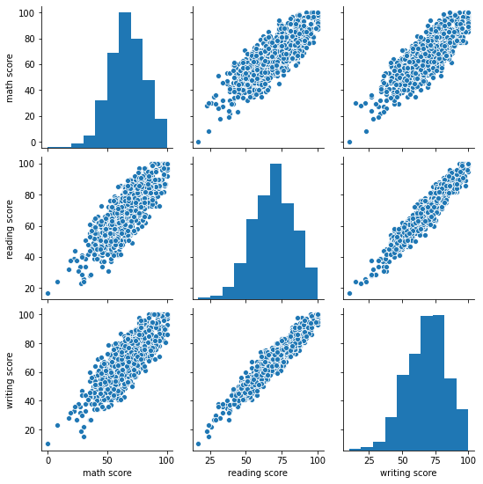
Seaborn
pairplot()

Slide 118
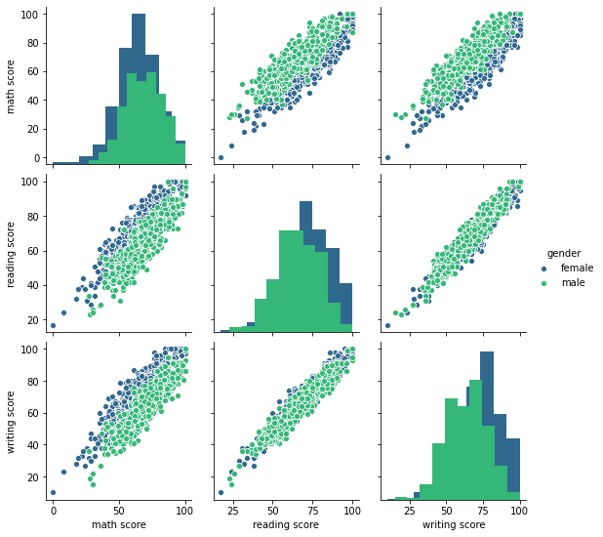
Seaborn
pairplot()

Slide 119
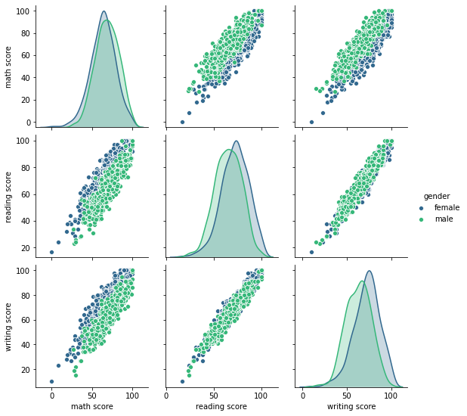
Seaborn
pairplot()

Slide 120
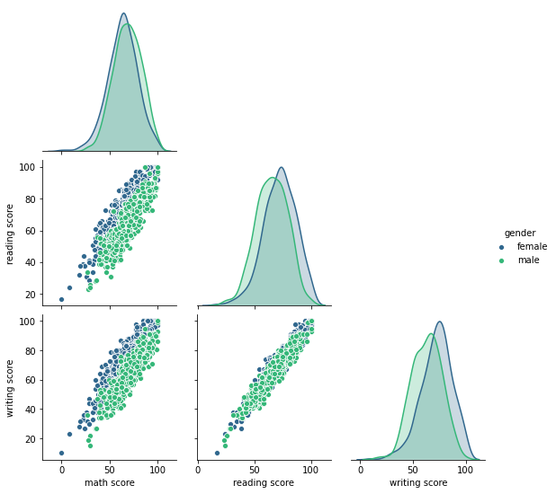
Seaborn
pairplot()

Slide 121
Seaborn
Let’s code out these comparison plots in the next lecture!

Slide 122
Comparison Plots
Part Two: Coding the Plots

Slide 123
Seaborn Grids

Slide 124
Seaborn
Seaborn grid calls use Matplotlib subplots() to automatically create a grid based off a categorical column.
Instead of passing in a specific number of cols or rows for the subplots, we can simply pass in the name of the column and seaborn will automatically map the subplots grid.

Slide 125
Seaborn
Many of seaborn’s built-in plot calls are running on top of this grid system.
Directly calling the grid system allows users to heavily customize plots.

Slide 126
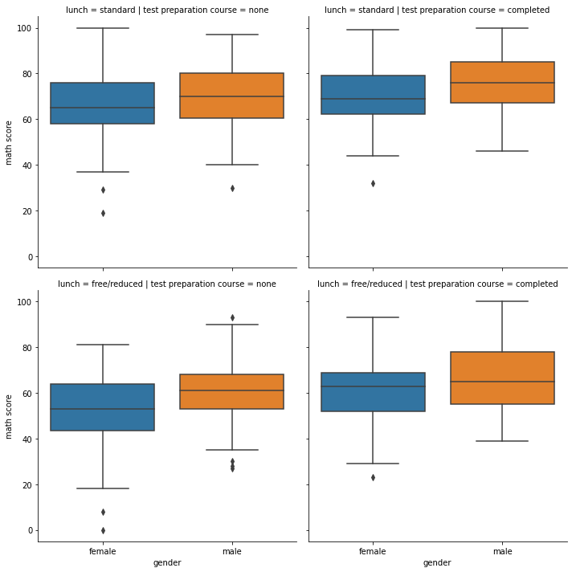
Seaborn
Creating subplots based on grids:

Slide 127
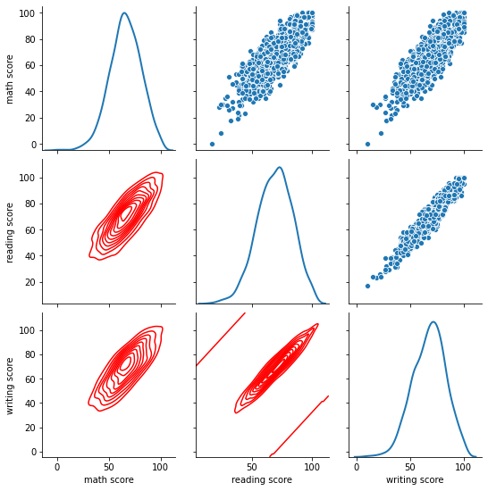
Seaborn
Map plots based on pairplot() grid:

Slide 128
Seaborn
This is best understood through code, so let’s jump to the notebook!

Slide 129
Matrix Plots

Slide 130
Seaborn
Matrix plots are the visual equivalent of displaying a pivot table.
The matrix plot displays all the data passed in, visualizing all the numeric values in a DataFrame.
Note!
Not every DataFrame is a valid choice for a matrix plot such as a heatmap.

Slide 131
Seaborn
The two main matrix plot types are:
heatmap()
Visually displays the distribution of cell values with a color mapping.
clustermap()
Same visual as heatmap, but first conducts hierarchical clustering to reorganize data into groups.

Slide 132
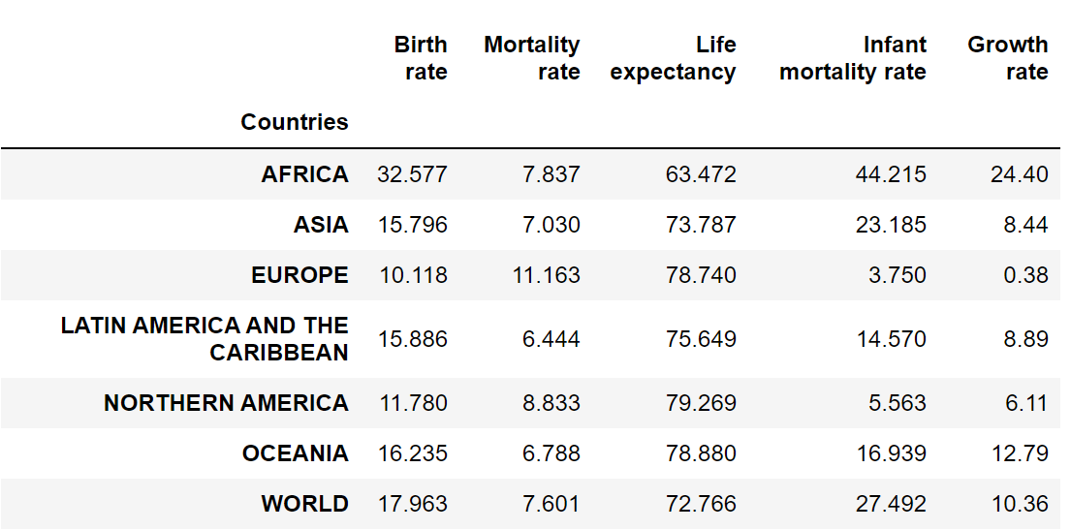
Seaborn
Heatmap

Slide 133
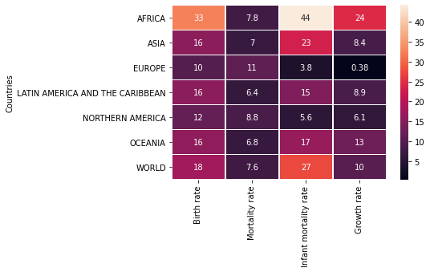
Seaborn
Heatmap

Slide 134
Seaborn
Note that a heatmap should ideally have all cells be in the same units, so the color mapping makes sense across the entire DataFrame.
In this particular case, all values were “rates” of percentage growth or change were in the heatmap.

Slide 135
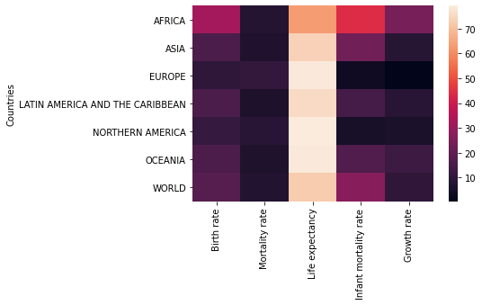
Seaborn
If we included age:

Slide 136
Seaborn
Seaborn also comes with the ability to automatically cluster similar groupings.
Later on we will discuss how this clustering is done when we learn about Machine Learning clustering techniques.

Slide 137
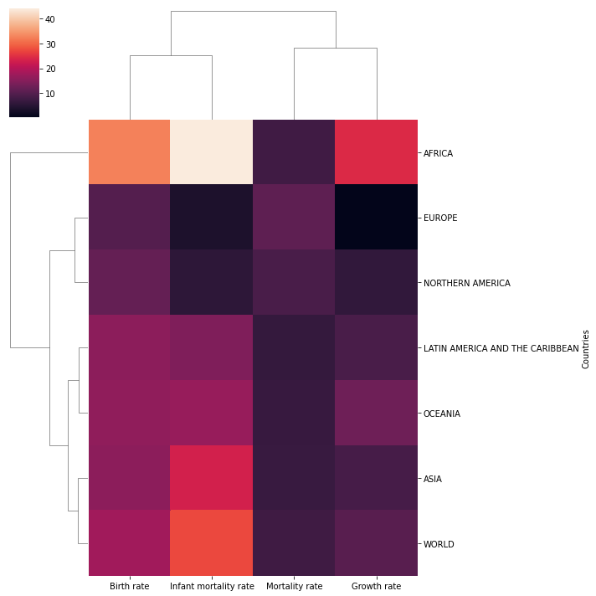
Seaborn

Slide 138
Seaborn
Let’s get to coding out these matrix plots!

Slide 139
Seaborn Exercises

Slide 140
Seaborn
Main goal of seaborn is to be able to use its simpler syntax to quickly create informative plots.
In general its difficult to test on seaborn skills since most plots are simply passing in the data and choosing x and y.

Slide 141
Seaborn
For these exercises we’ve inserted jpg images of seaborn plots we want you to replicate.
Don’t worry if you don’t get coloring or dimensions exactly the same as ours, focus on the general plots and relationships visualized.

Slide 142
Seaborn
Read the plot descriptions carefully!
Most of these plots have filtering and adjustments with pandas on the DataFrame before being passed into the seaborn call.

Slide 143
Seaborn Exercises
Solutions

